Slide 1
APOMIXIS
Apomixis is the mechanism of seed production without fertilization. ... Apomixis is of high importance as; It produces seed progeny which are exactly the same as the mother plant. Thus apomixis helps in the preservation of good characters over generations for crop plants.

Slide 2
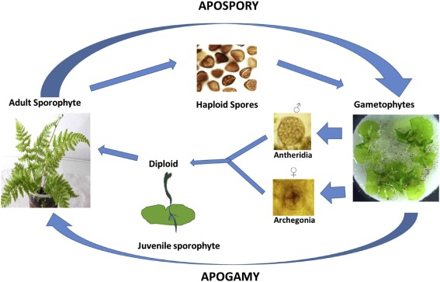

Slide 3
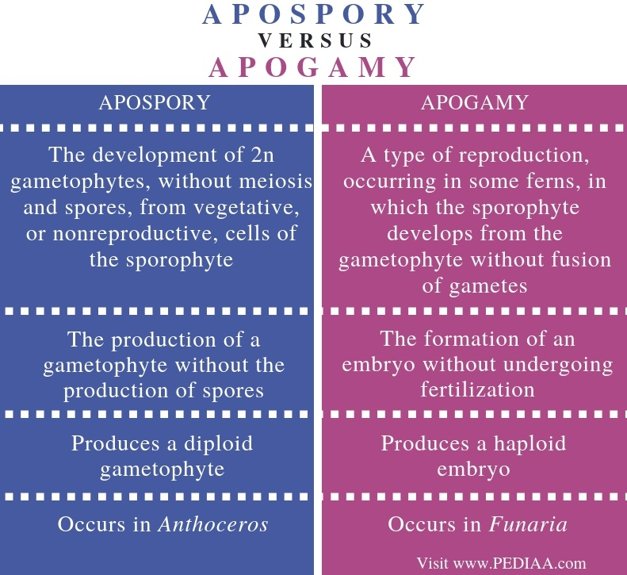

Slide 4
*The main difference between apospory and apogamy is that apospory is the development of a gametophyte directly from the sporophyte without undergoing either meiosis or spore formation whereas apogamy is the development of an embryo without fertilization.
* Furthermore, apospory occurs in Anthoceros while apogamy occurs in Funaria.
*Apospory and apogamy are two terms that describe methods of asexual reproduction which alter the usual sexual reproduction of plants.

Slide 5
*Similarities Between Apospory and Apogamy:
Apospory and apogamy are two methods of asexual reproduction altering the usual sexual reproduction in plants.
*In both methods, the sporophyte produces different types of reproductive units without undergoing meiosis.
*Therefore, there is no production of gametes.
Also, these two methods mainly occur in bryophytes and less commonly ferns and lycopods.

Slide 6
*Apospory is the production of a gametophyte by the sporophyte without undergoing meiosis or formation of spores.
*As there is no meiosis in apospory, the gametophyte is diploid. In contrast, apogamy is the formation of an embryo without undergoing fertilization.
*Therefore, the forming sporophyte from the embryo is always haploid.
*Both apospory and apogamy are two types of asexual reproduction methods which alter the regular sexual reproduction.
*However, the main difference between apospory and apogamy is the type of reproductive structure produced in each process and their ploidy.

Slide 9
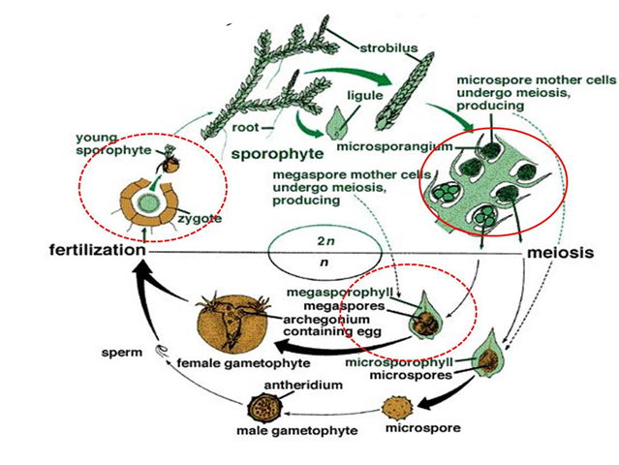

Slide 10
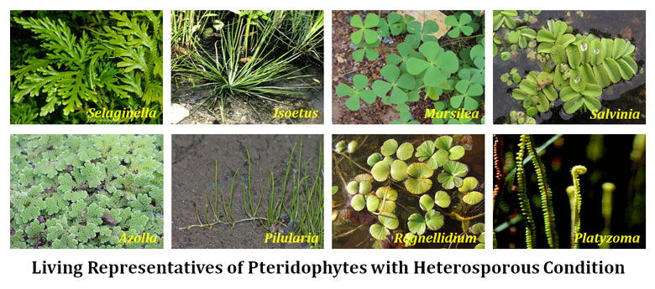

Slide 11
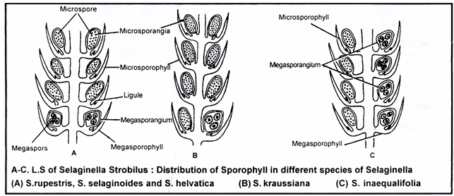

Slide 12
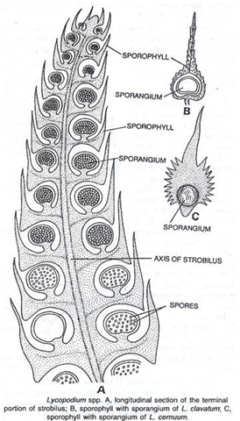

Slide 13
